Slide 1
Python
Lua
Java
JavaScript
Rust

Slide 2
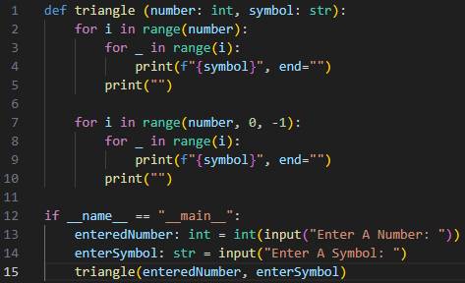
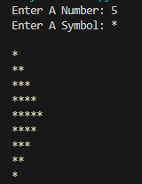
Python
Python is a multi-paradigm language with both Object-oriented and structured
This example takes in a user input for the number and a symbol and prints out a triangle

Slide 3
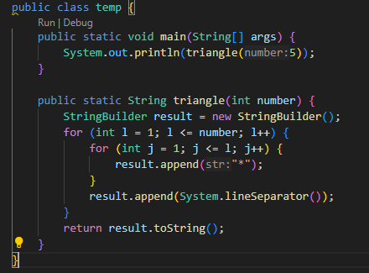

Java
Java is also a multi-paradigm language but mainly known for object-oriented programming. It has also incorporated parts of functional and imperative.

Slide 4
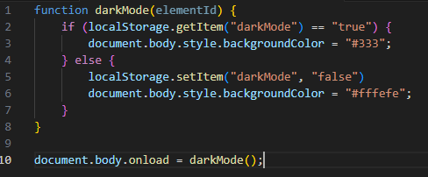
JavaScript
The example Java script checks for a local storage variable “darkmode”, if true it sets the pages body to a shade of black when the body loads.
While JS can do OOP this example uses procedural programming.

Slide 5
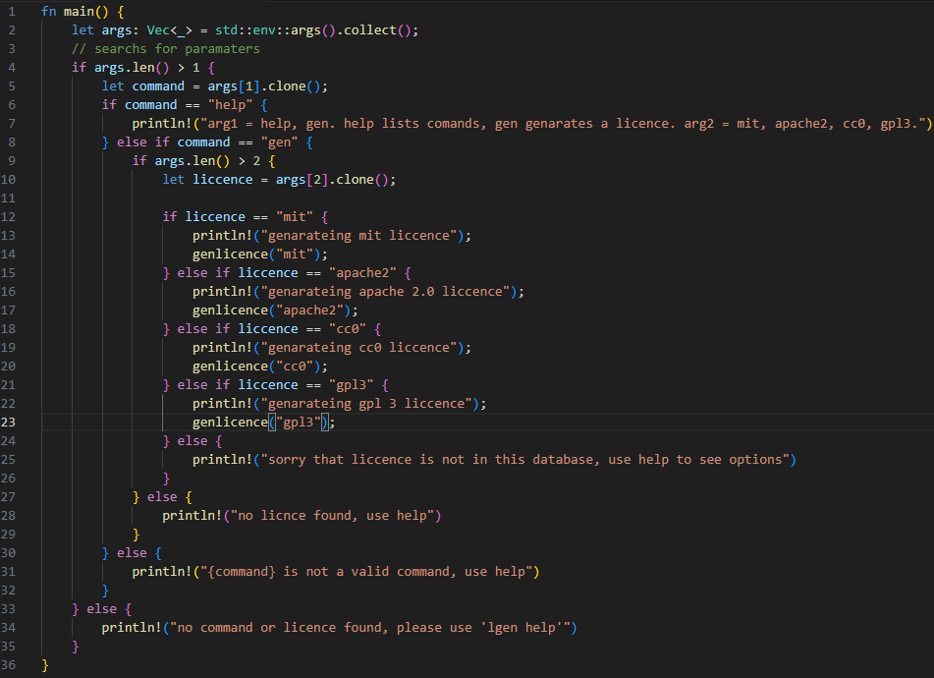
Rust
This is a rust function that reads your input and calls a licence generation function based on your input.
This example uses procedural programming.

Slide 6
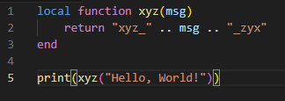

Lua
This a simple function that returns your string with xyz and zyx on the side of it. After which is a print which calls it with a hello world string.
This example uses procedural programming.

